Slide 1
KING PIM Project
Florin Dascalu

Slide 2
Production Information Management system
Starting page: Login
Dashboard Page
Categories & Subcategories Page (List, Edit, Delete Category + Create new Subcategory)
Subcategory Page (List, New, Edit, Delete Subcategory + Create new Product)
Products List in every Subcategory (Delete selected product or Bulk products from Subcategory, Update products list)
Product Page (fill fields, Publish, Delete, Update fields is registered by Account name and date)
Built on: .NET Platform (ASP .NET Core MVC) in frontend and .NET Core and C# in backend, Entity Framework for SQL database
Used: JQuery, Twitter Bootstrap, ASP.NET Identity (Identity Seeder), Browser support: Google Chrome

Slide 3
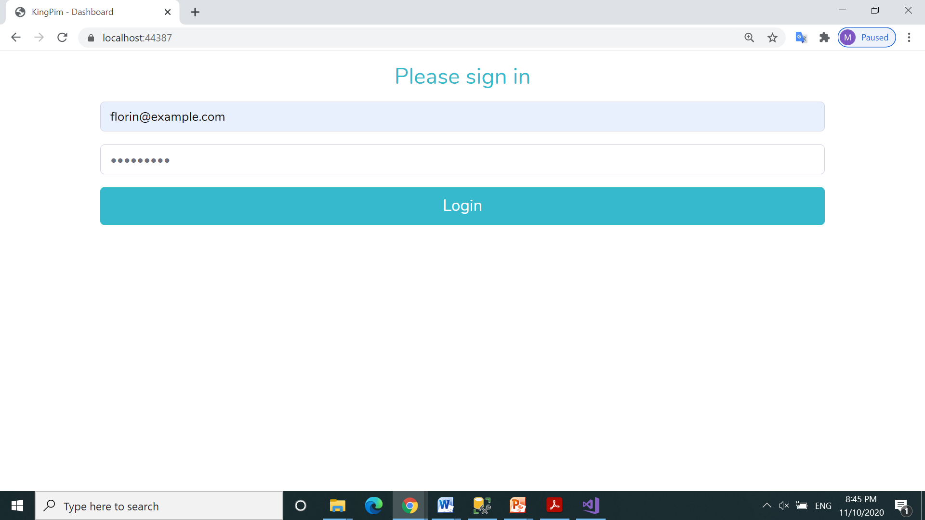
Starting page: Login – connect
florin@example.com, pass: buggeroff

Slide 4
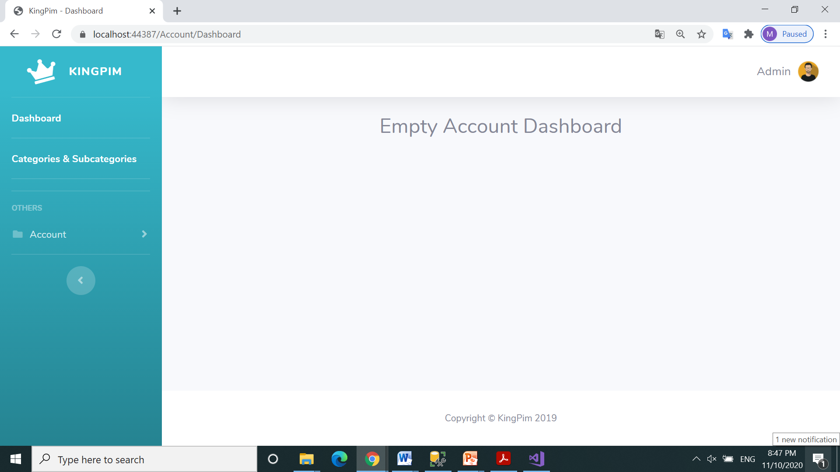
Click on Categories & Subcategories link

Slide 5
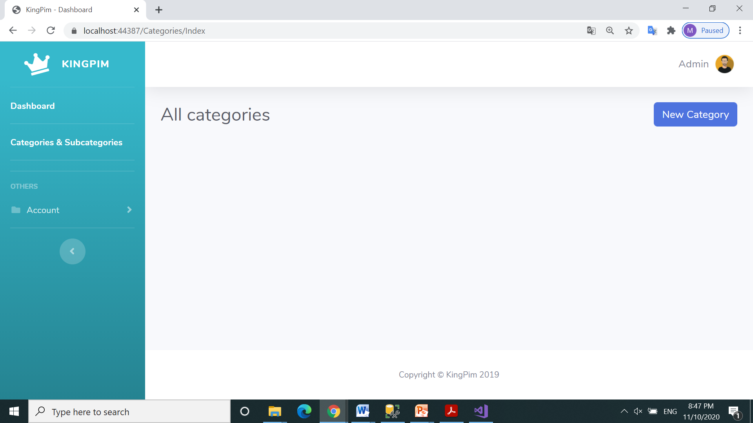
All categories page
Add a New Category

Slide 6
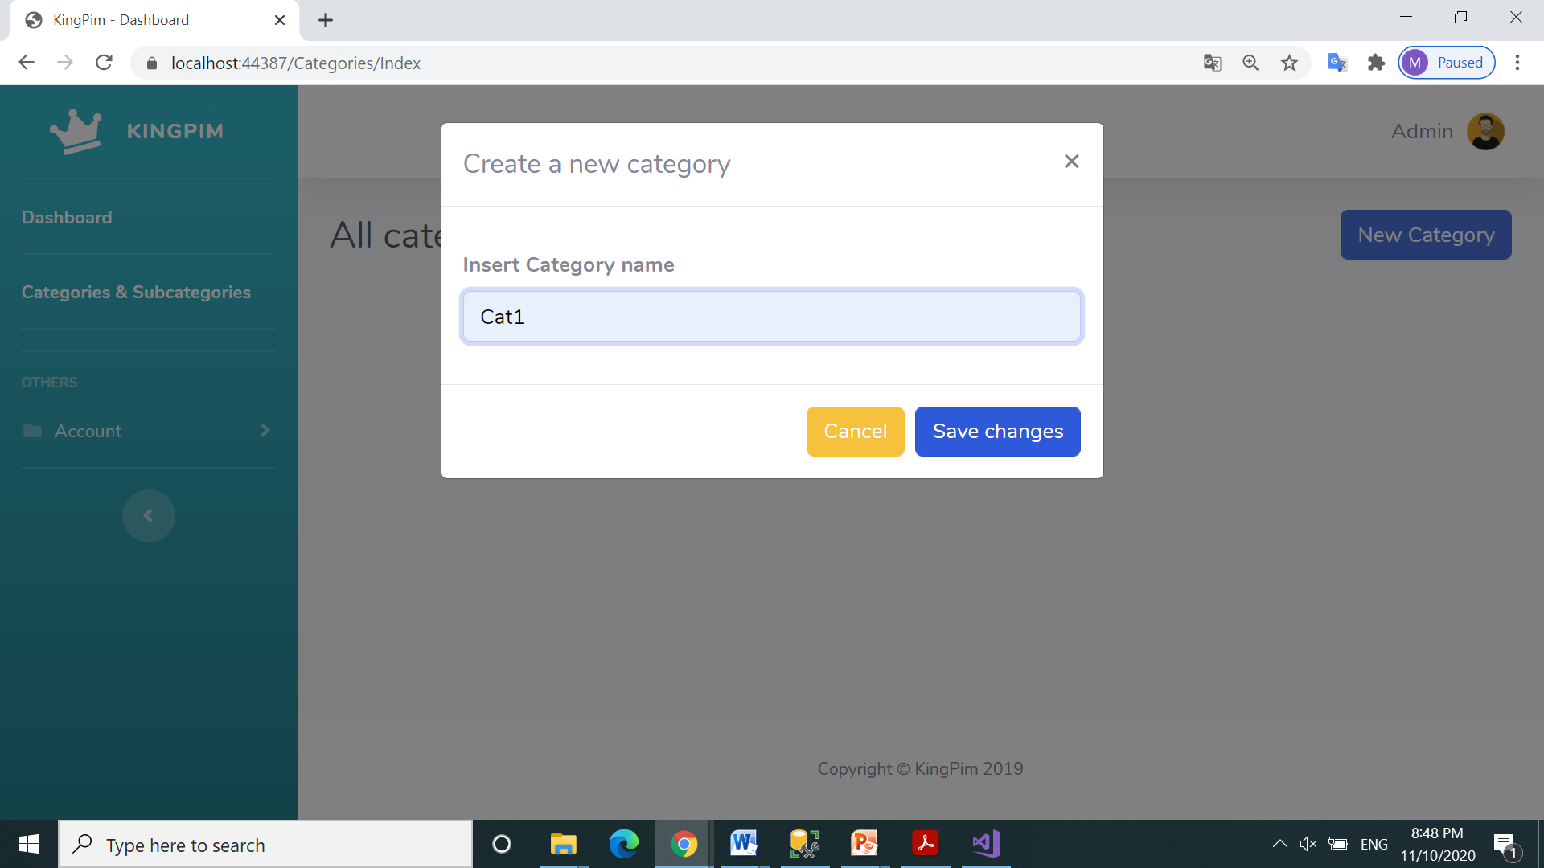
Confirm New Category – Cat1

Slide 7
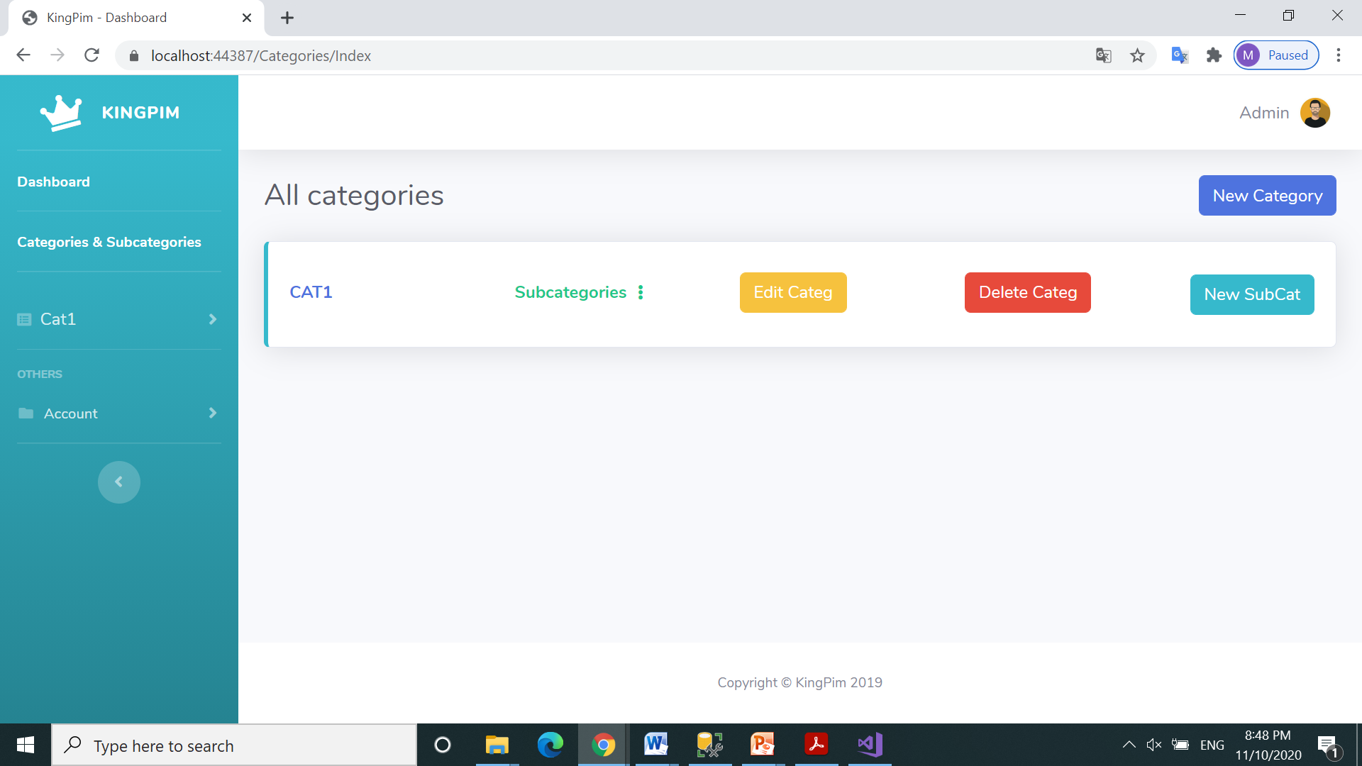
Return to List Category and Click on New Category button

Slide 8
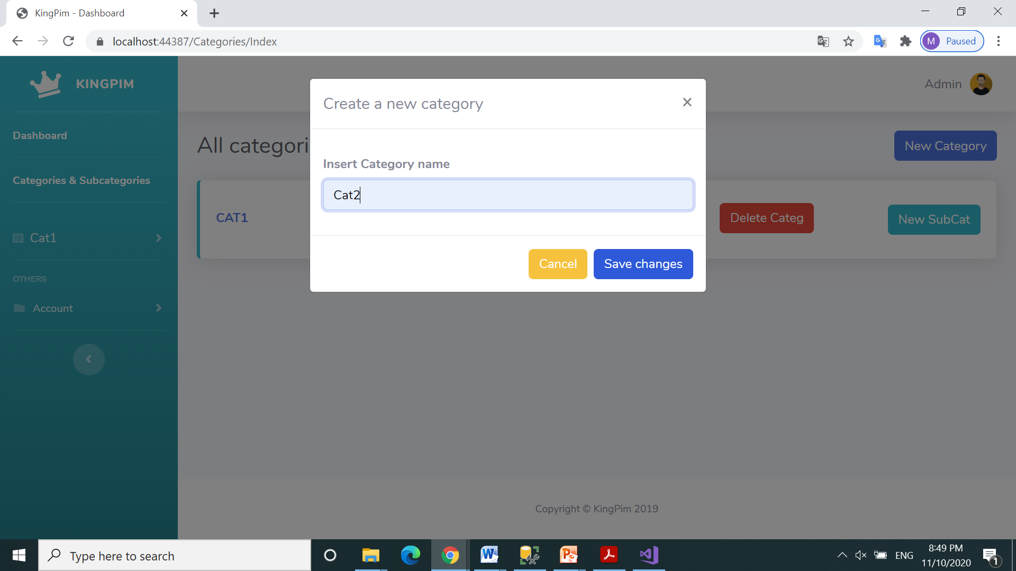
Confirm New Category – Cat2

Slide 9
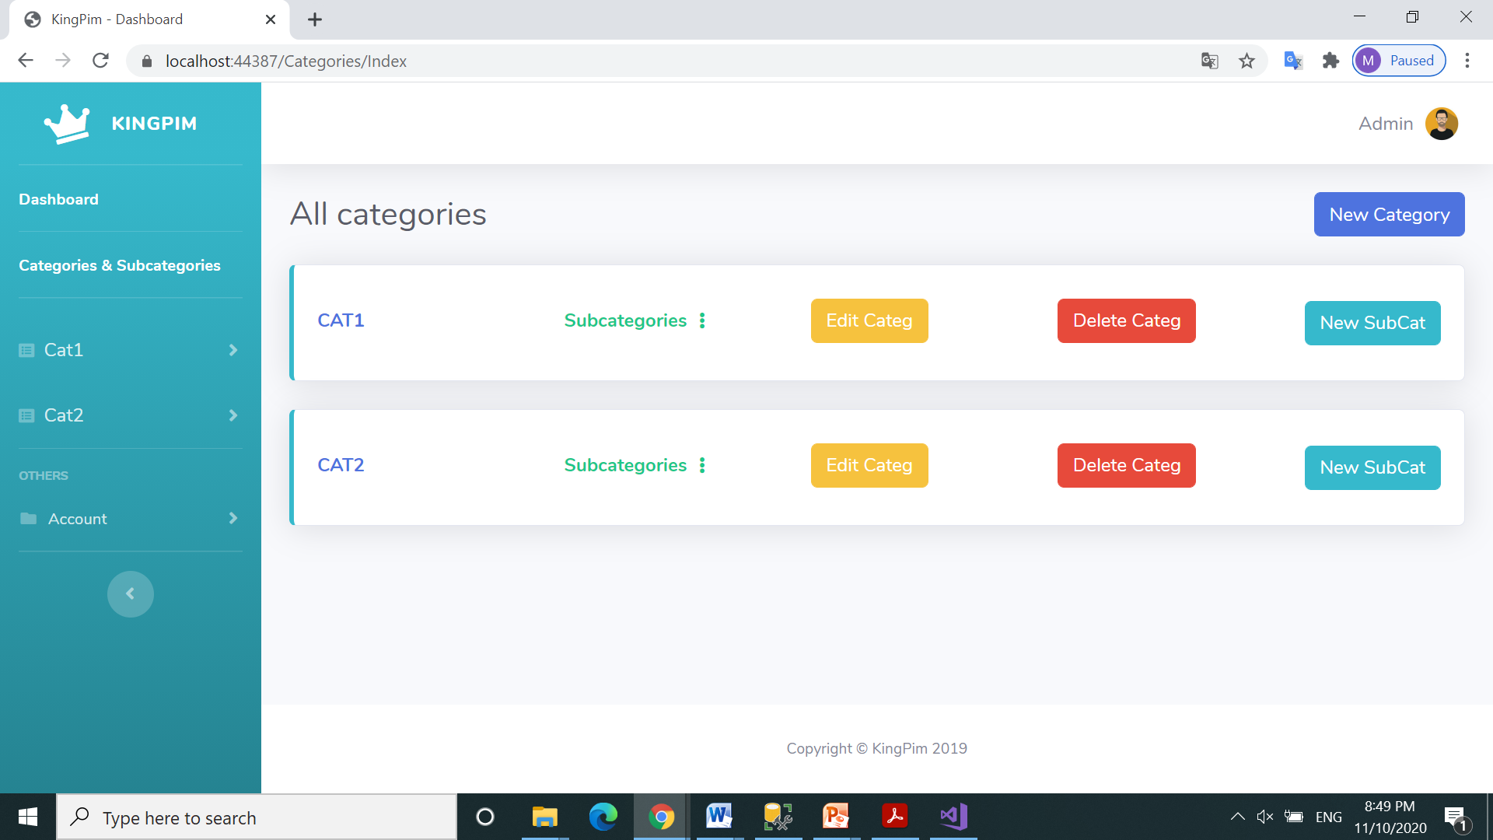
List Category and Click on New Subcategory button

Slide 10
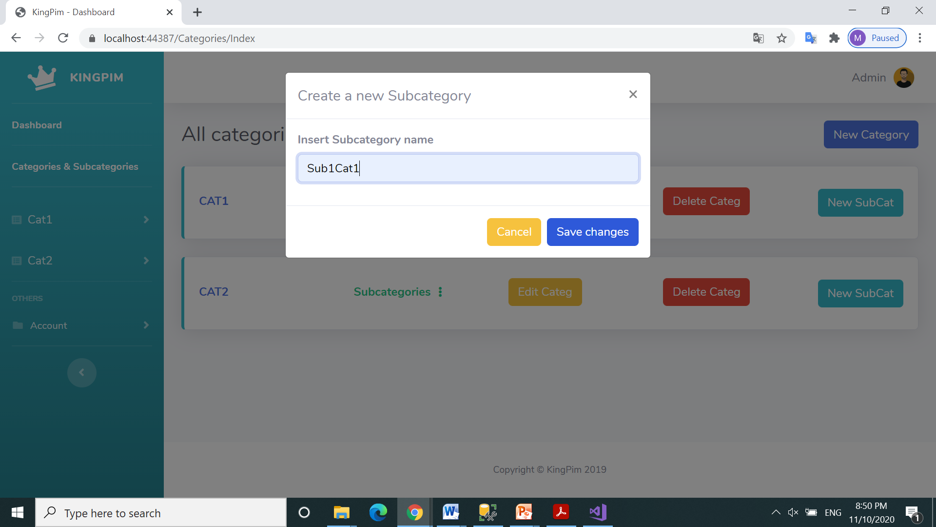
Confirm New Subcategory - Sub1Cat1

Slide 11
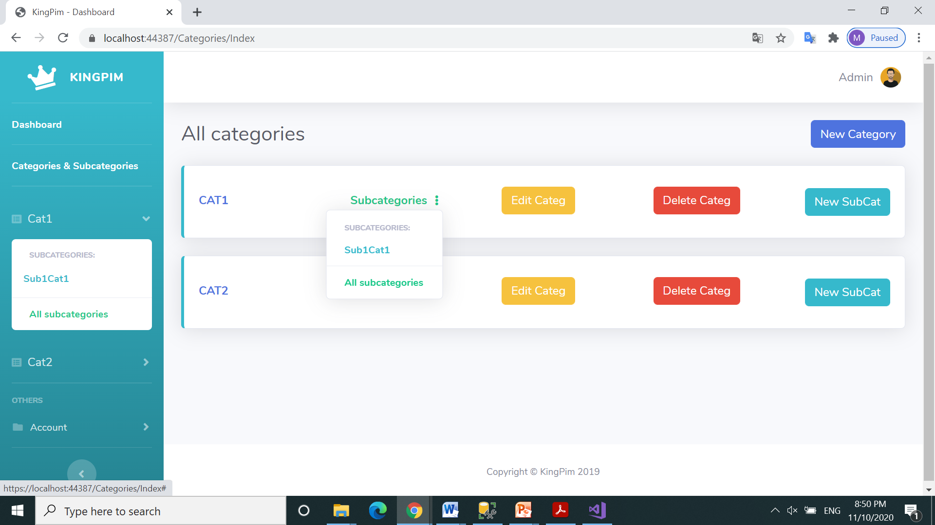
List all Subcategories in Category Cat1
Click to create a new Subcategory in Cat1

Slide 12
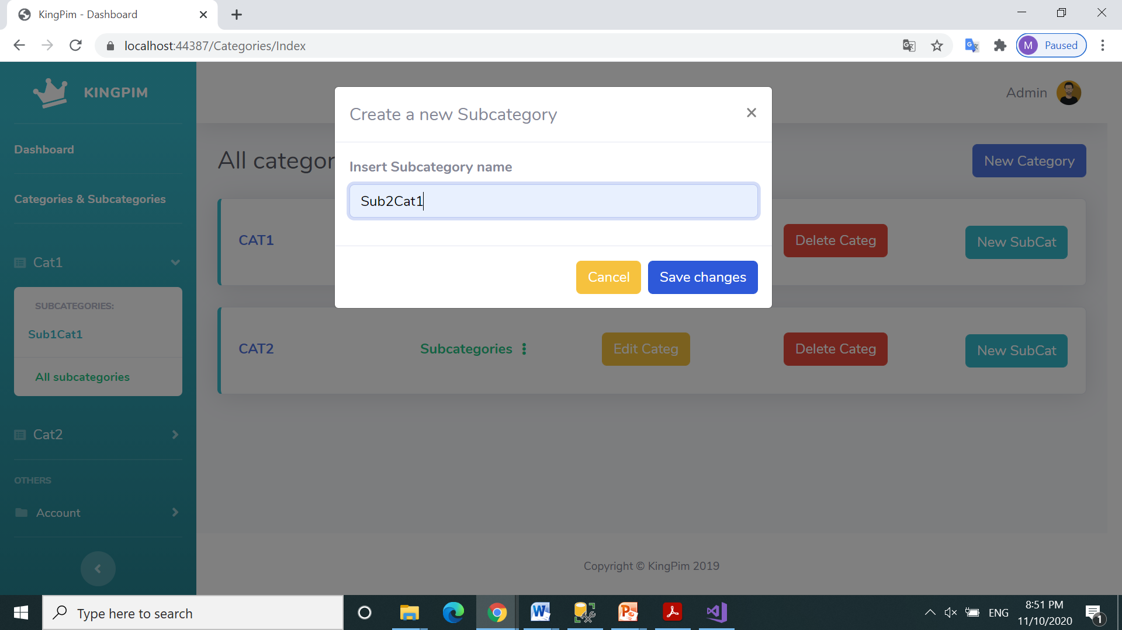
Confirm New Subcategory - Sub2Cat1

Slide 13
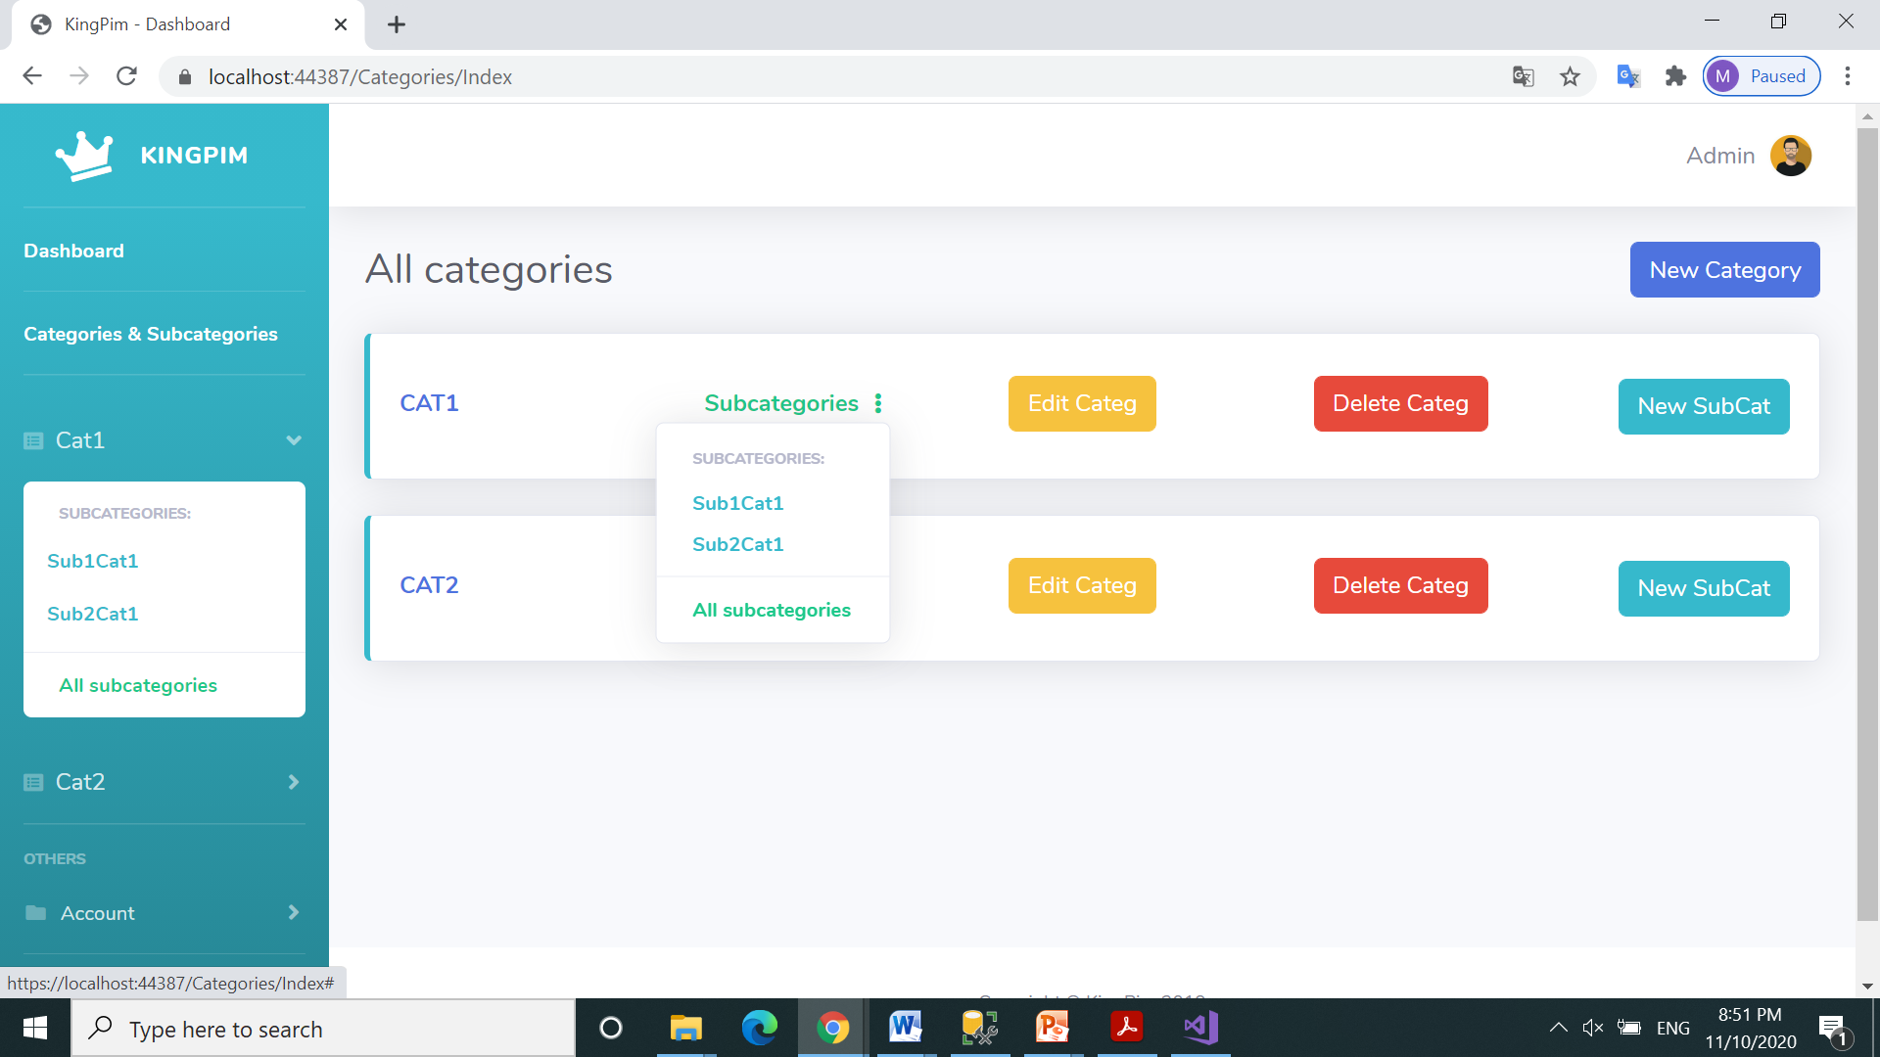
List all Categories and Subcategories for Cat1
Click to Subcategory Sub1Cat1

Slide 14
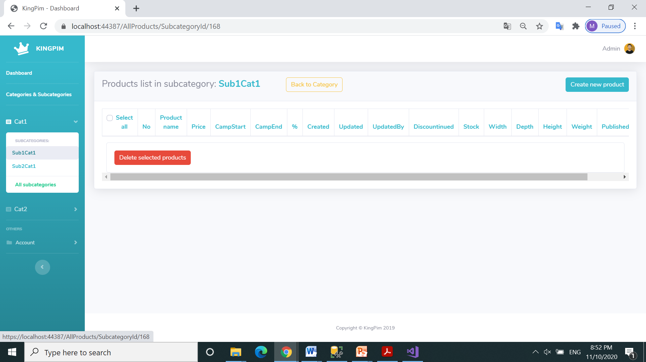
Click to Create new product in subcategory Sub1Cat1

Slide 15
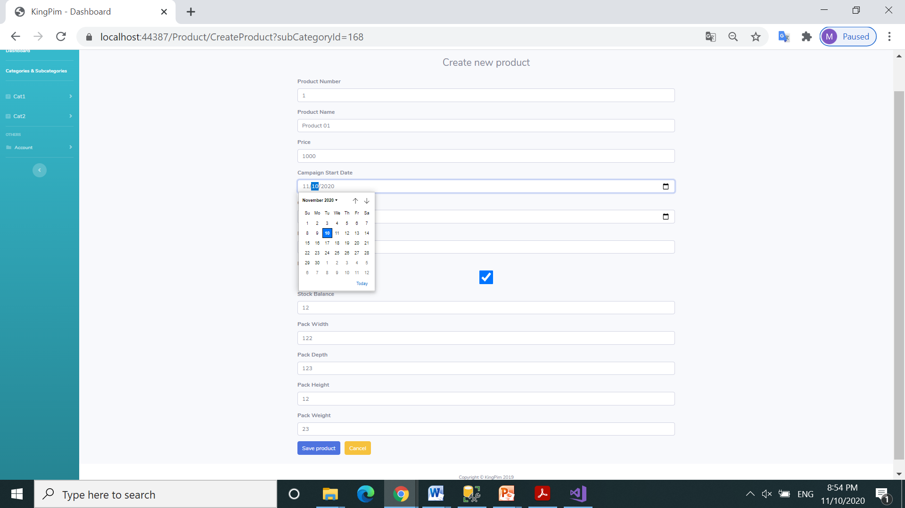
Fill all fields and click Save product

Slide 16
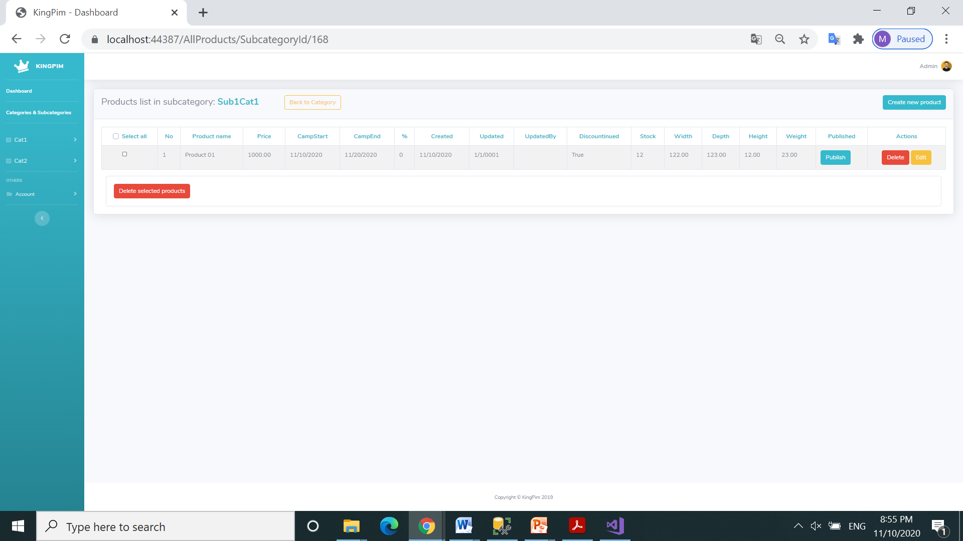
Click to Edit the product from Product list in subcategory Sub1Cat1

Slide 17
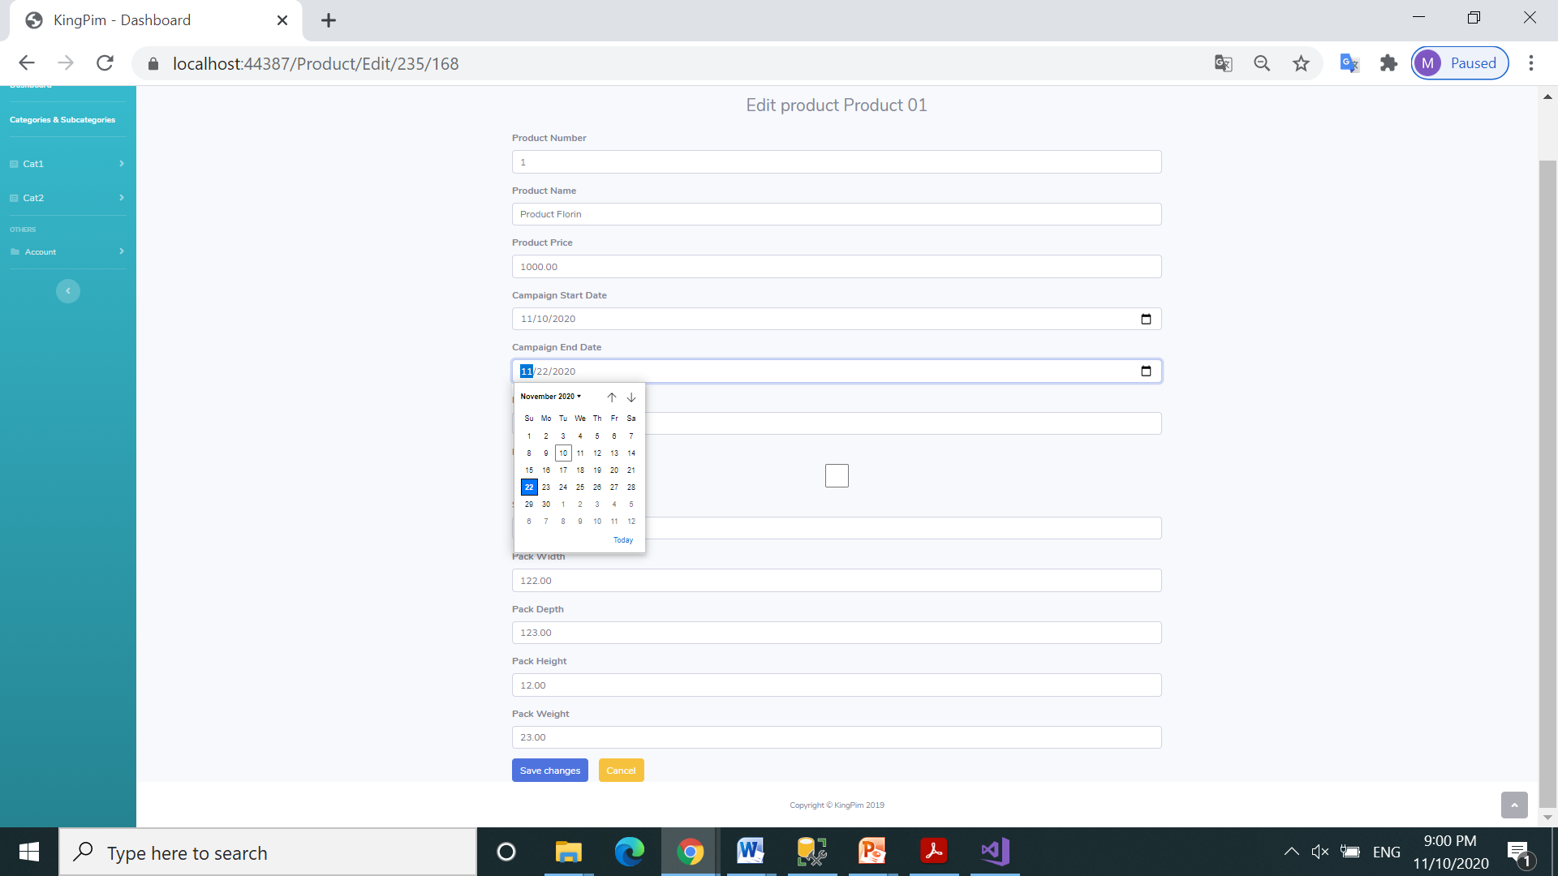
Change fields and click Save changes

Slide 18
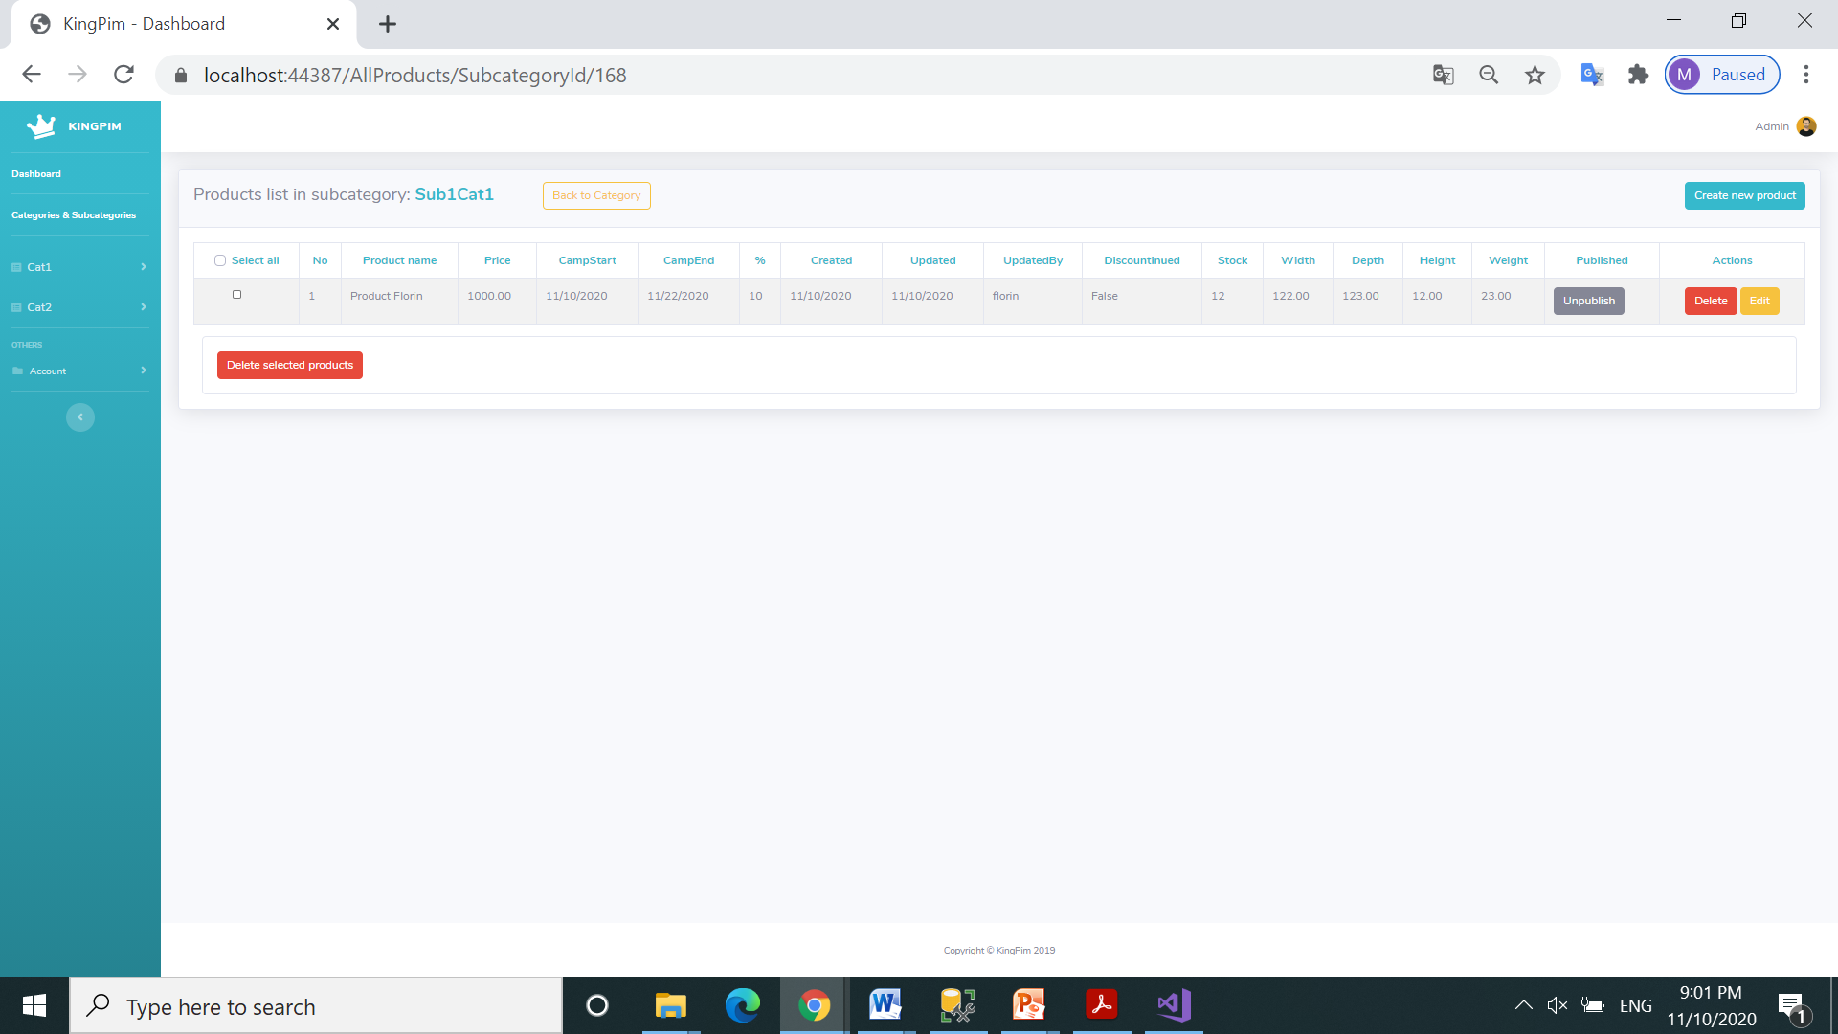
Fields Updated and UpdatedBy are now updated

Slide 19
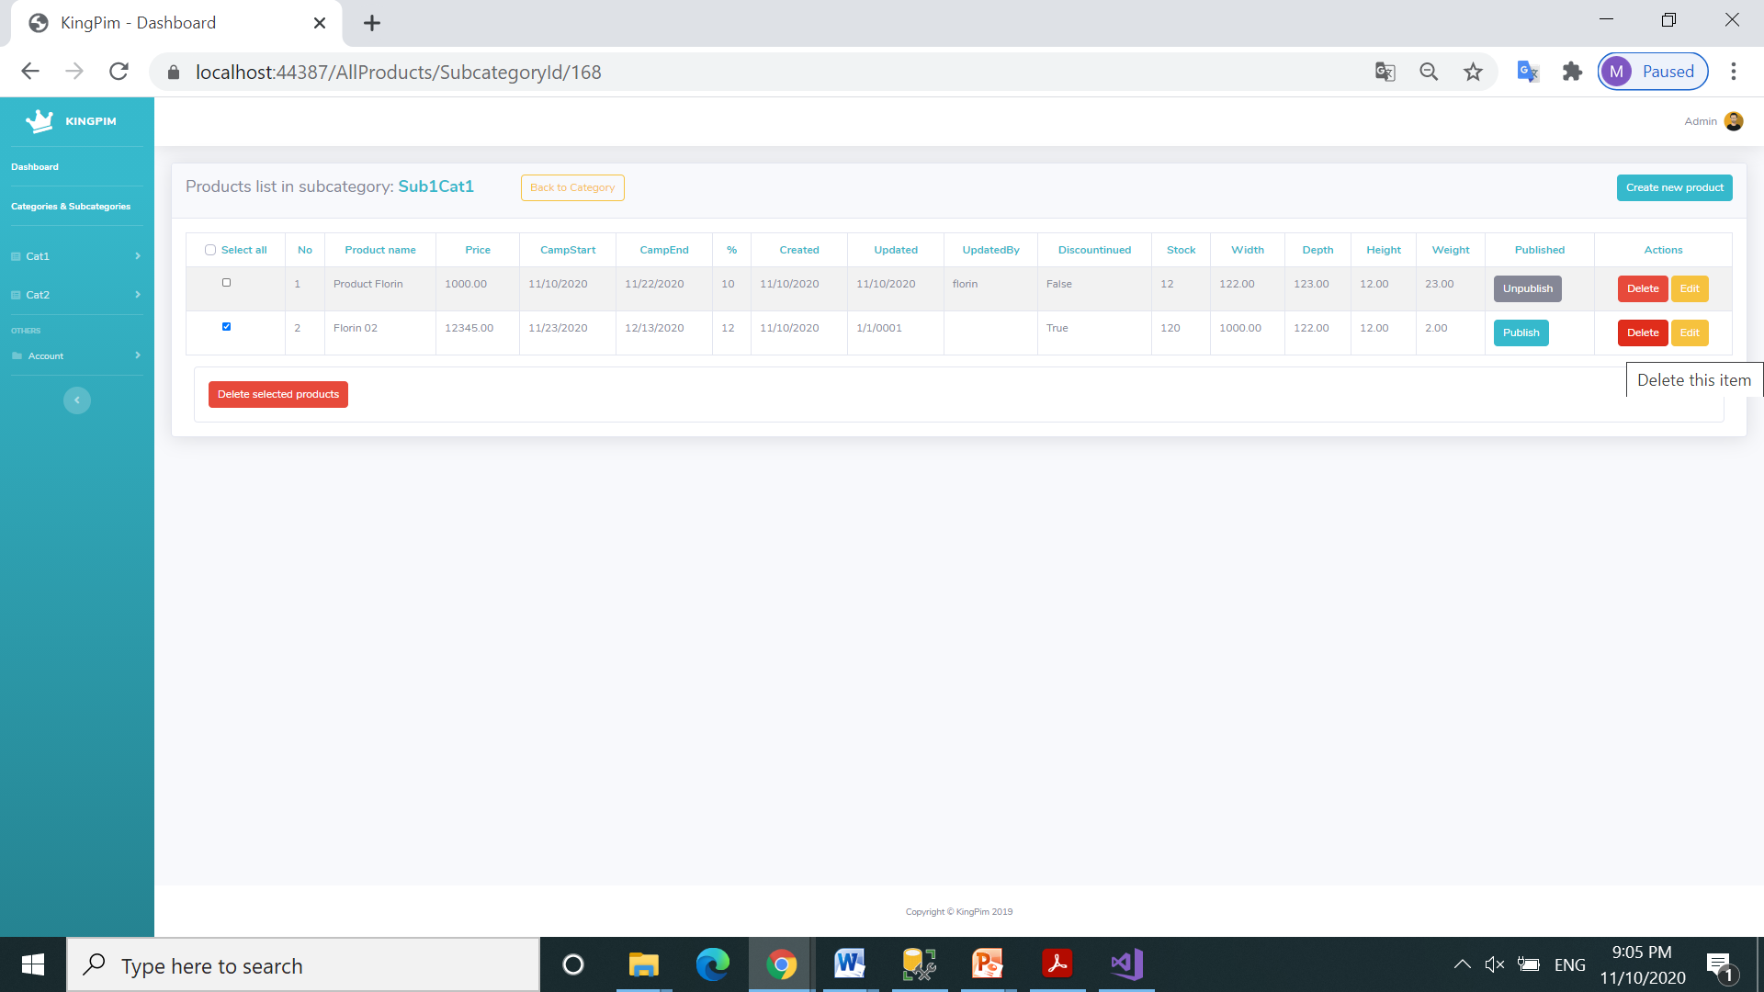
Click to delete a product

Slide 20
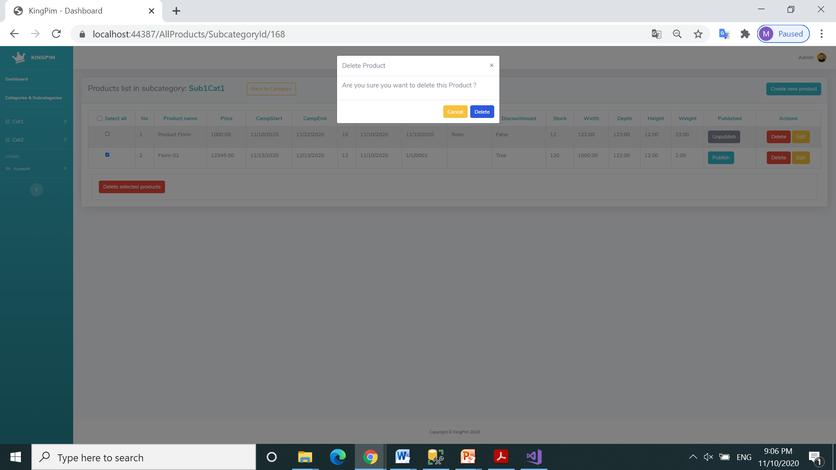
Confirm delete a product

Slide 21

Click to link Cat1

Slide 22
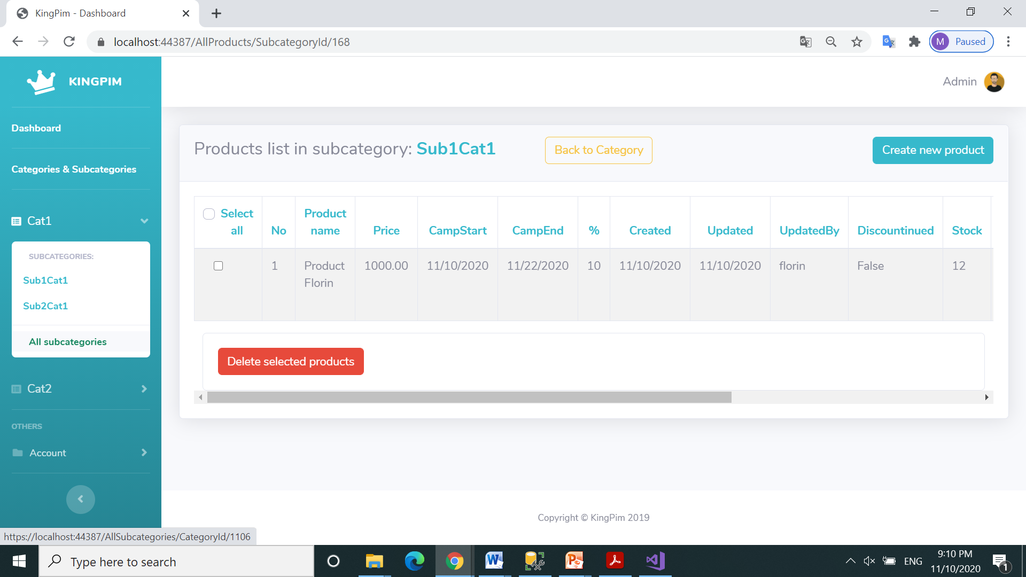
Click to list all subcategories from category Cat1

Slide 23
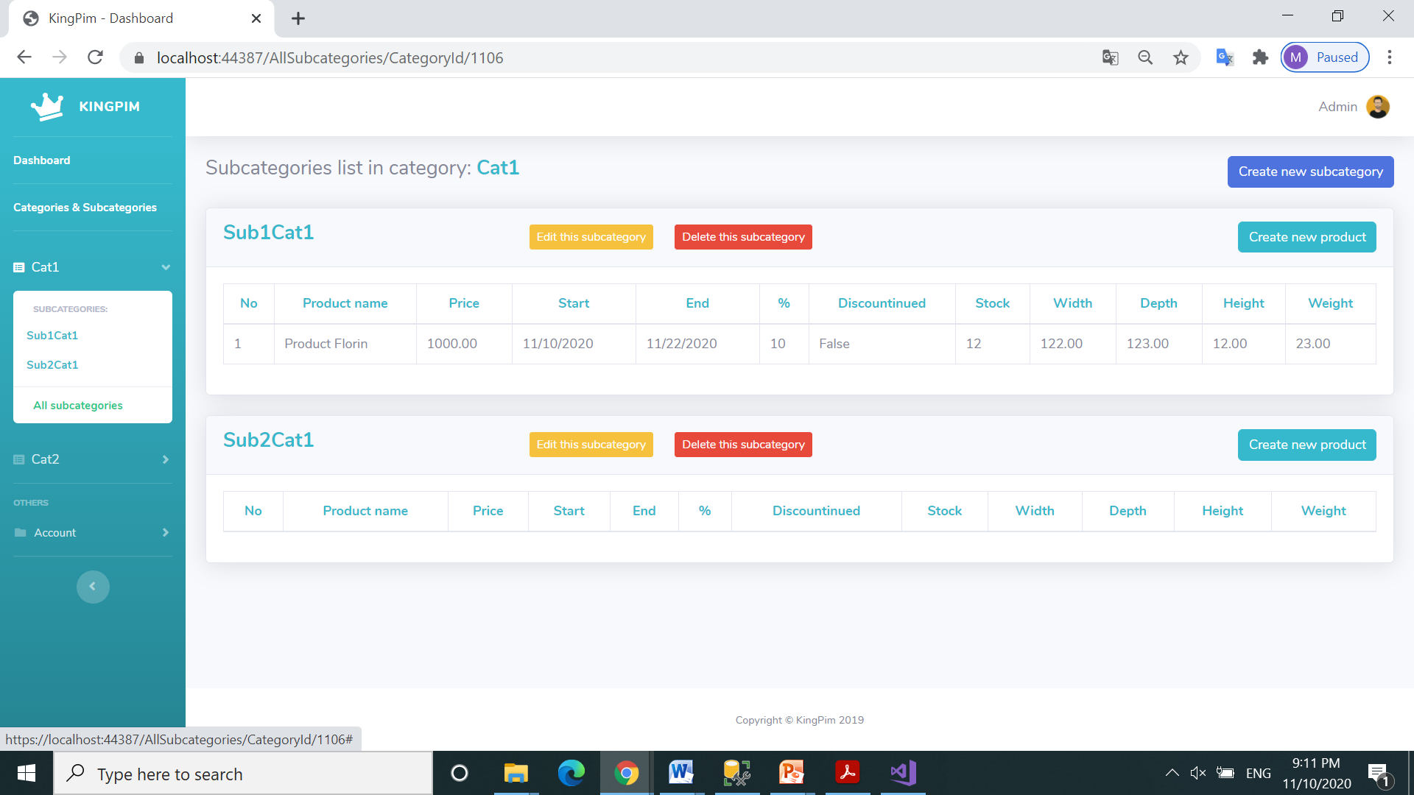
Click to edit name of subcategory Sub2Cat1

Slide 24
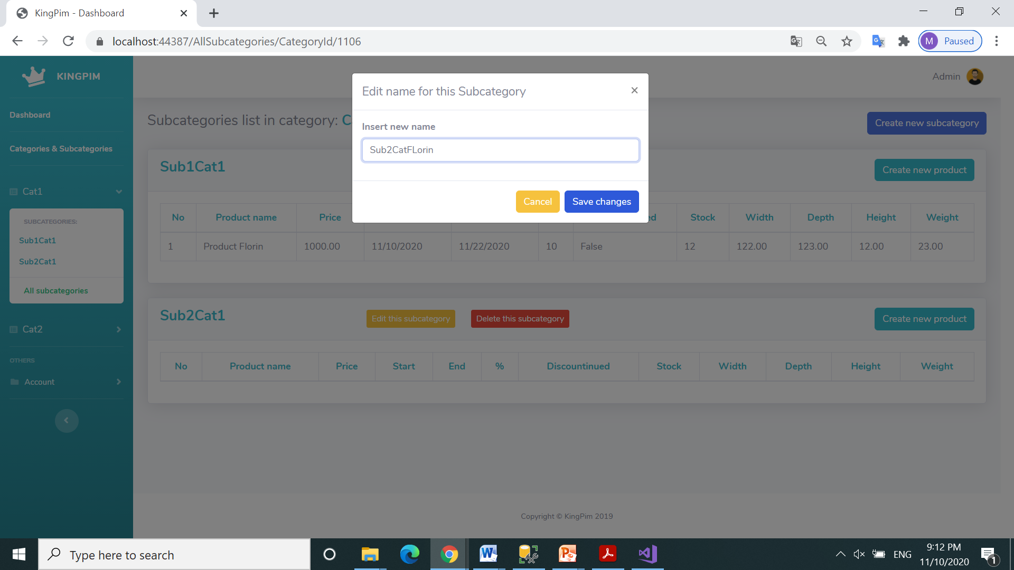
Change name of this subcategory in Sub2CatFlorin

Slide 25
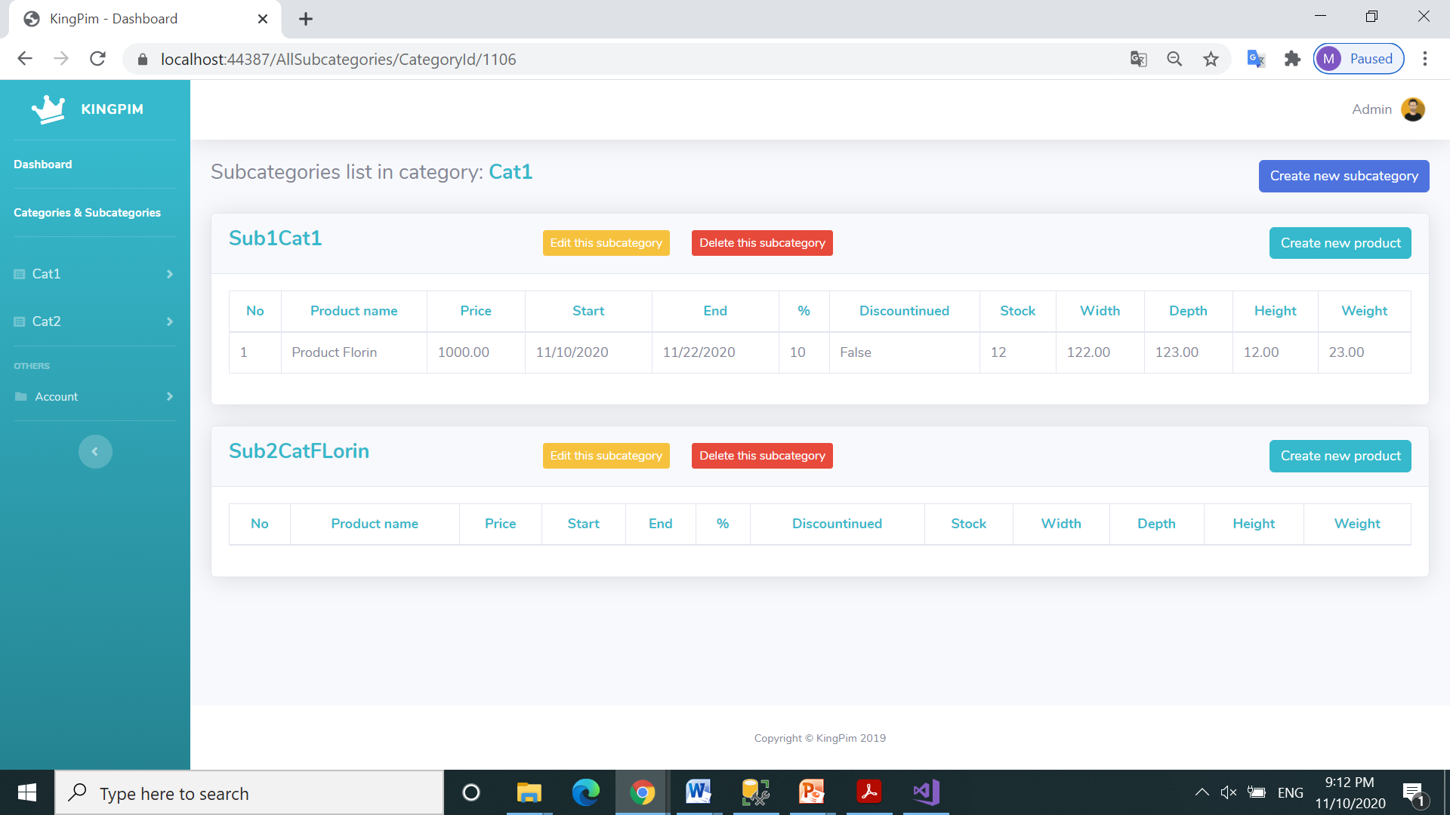
Visualize subcategory new name: Sub2CatFlorin

Slide 26
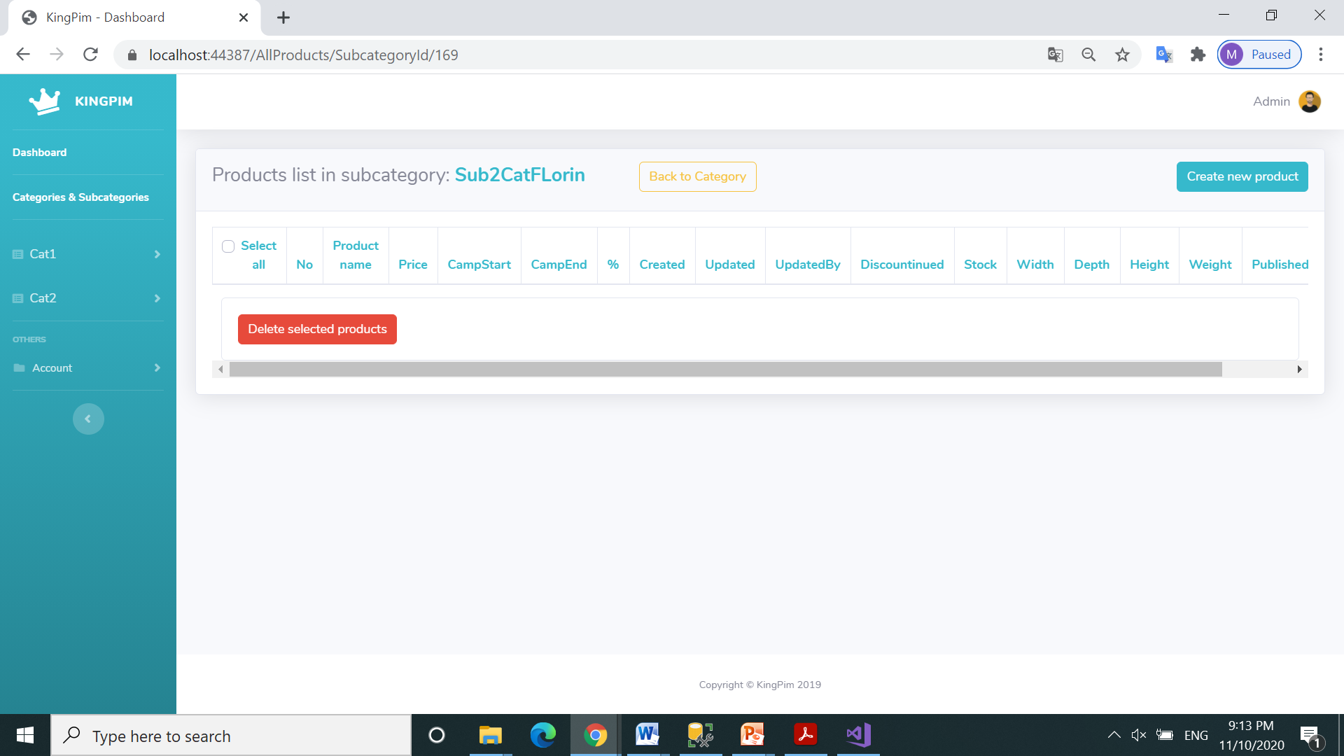
Click back to Categories & Subcategories page

Slide 27
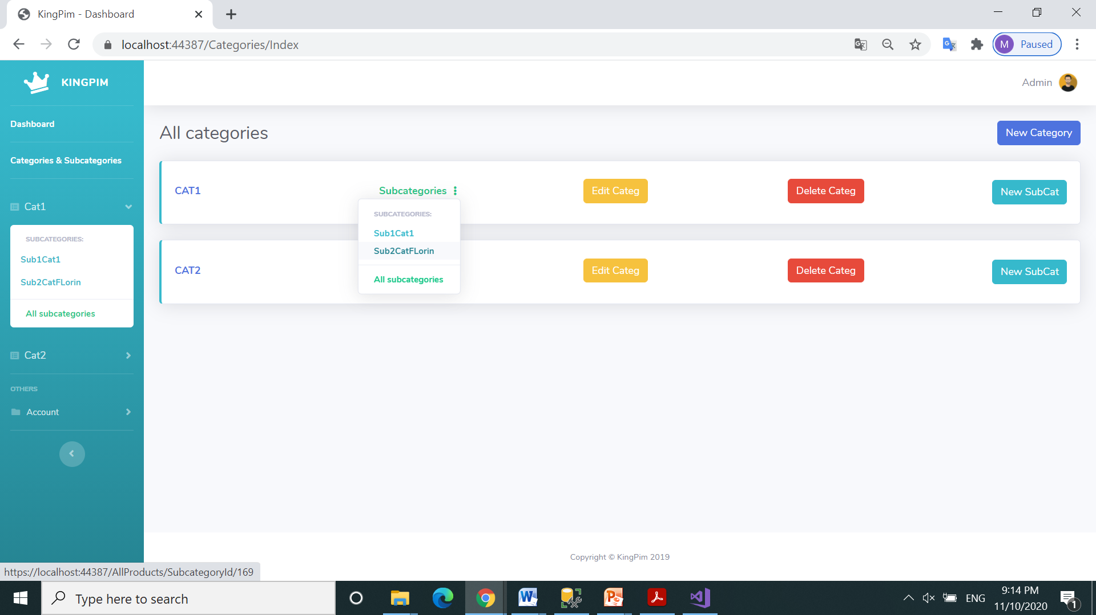
Click to list all subcategories from category Cat1

Slide 28

Click to delete subcategory Sub2CatFlorin

Slide 29
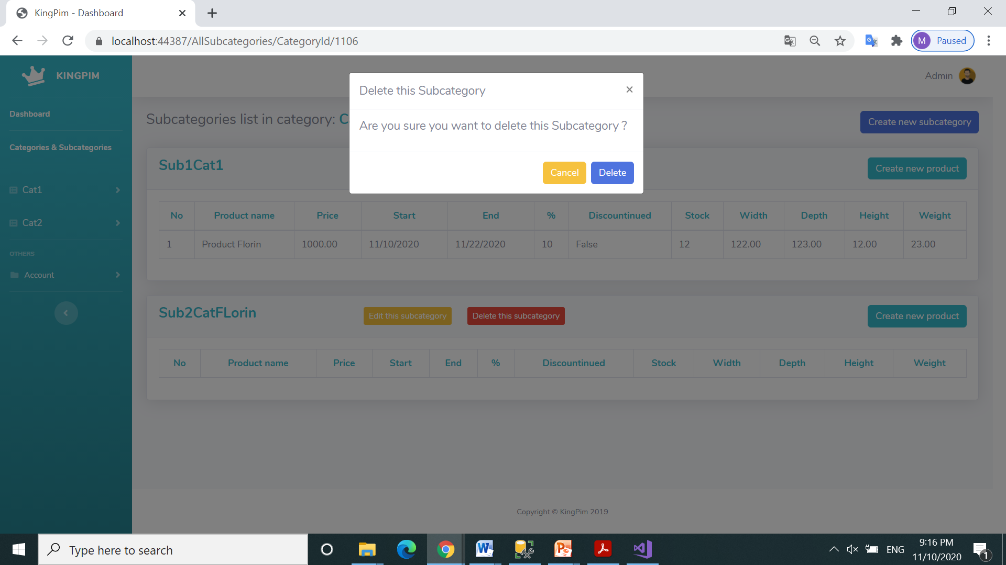
Click to confirm delete subcategory Sub2CatFlorin

Slide 30
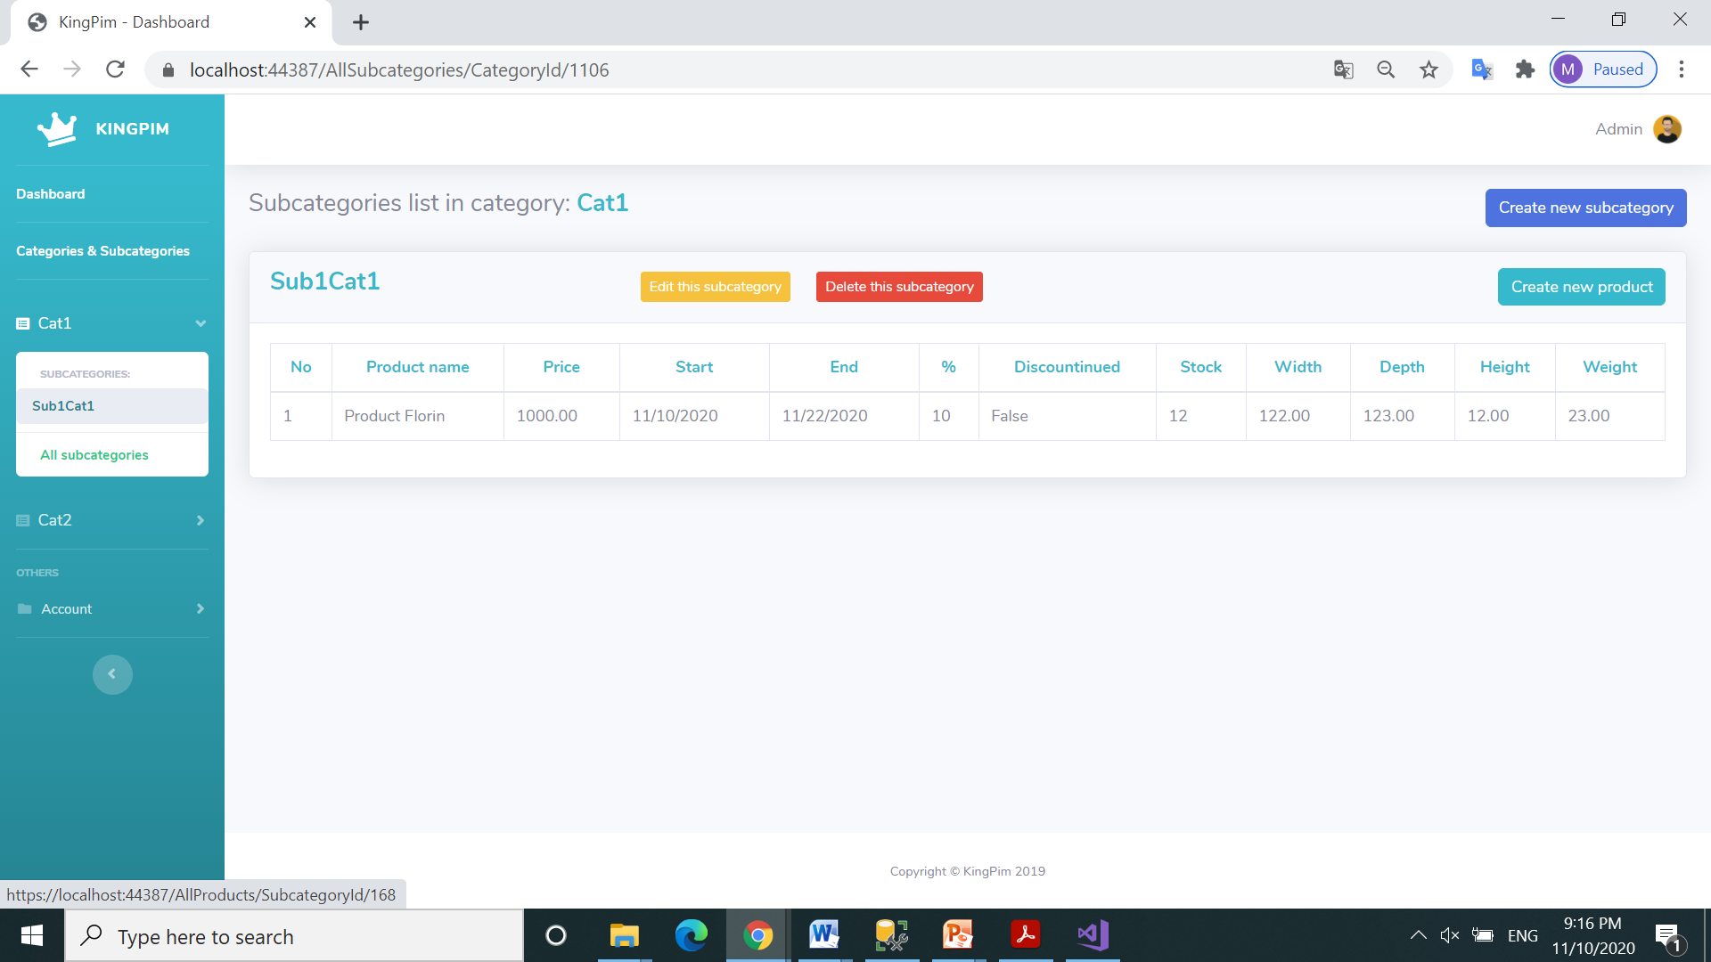
Click back to Categories & Subcategories page

Slide 31
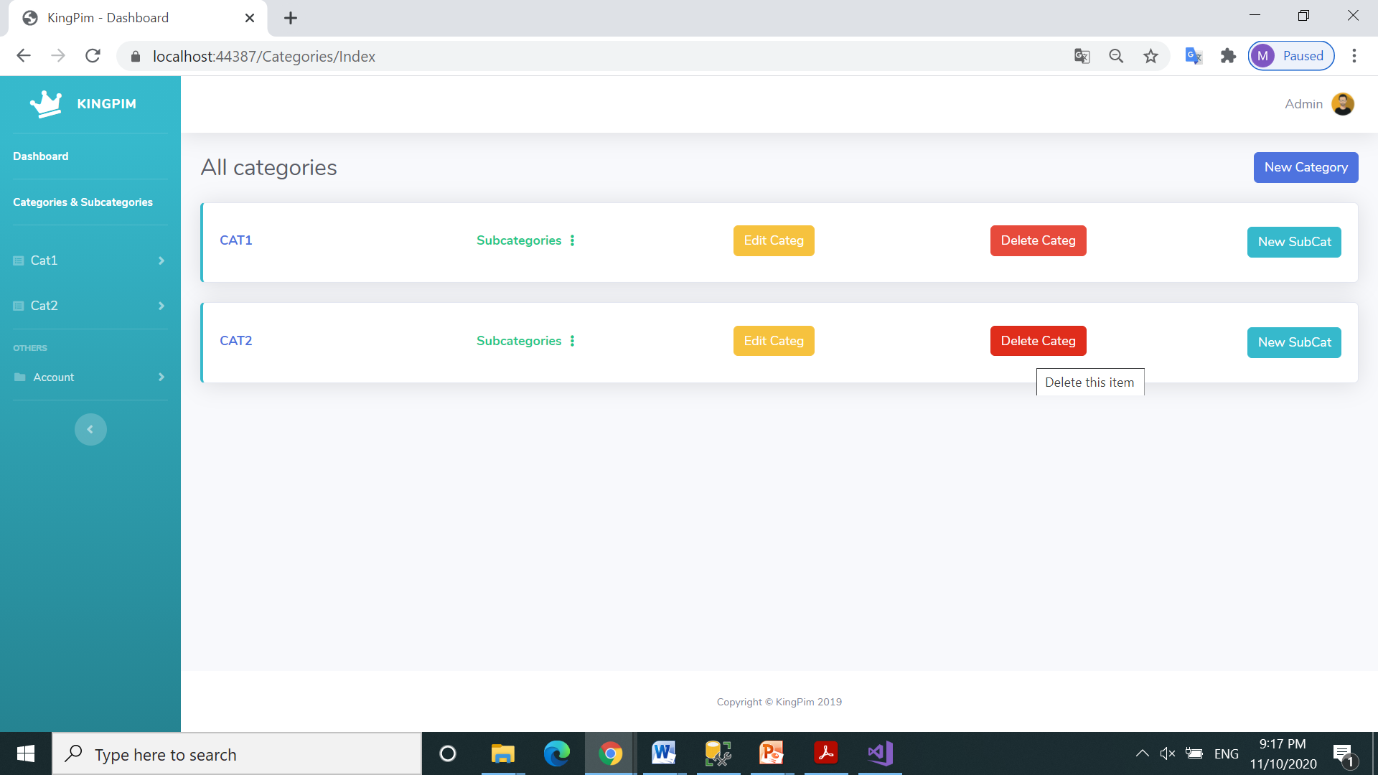
Click to delete category Cat2

Slide 32
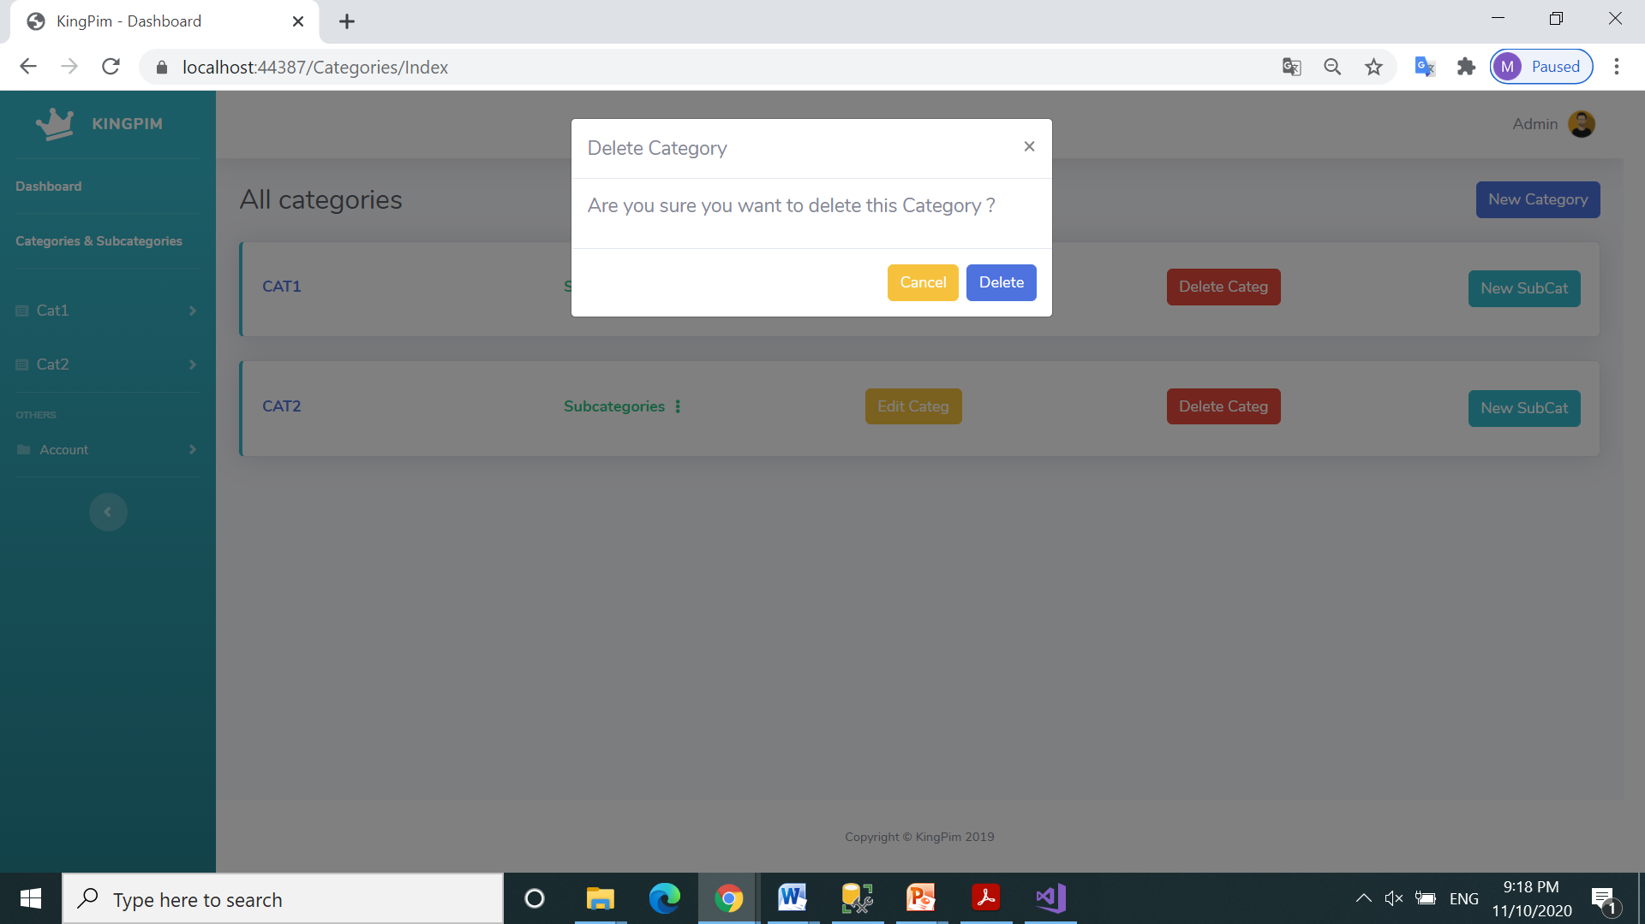
Confirm delete category Cat2

Slide 33
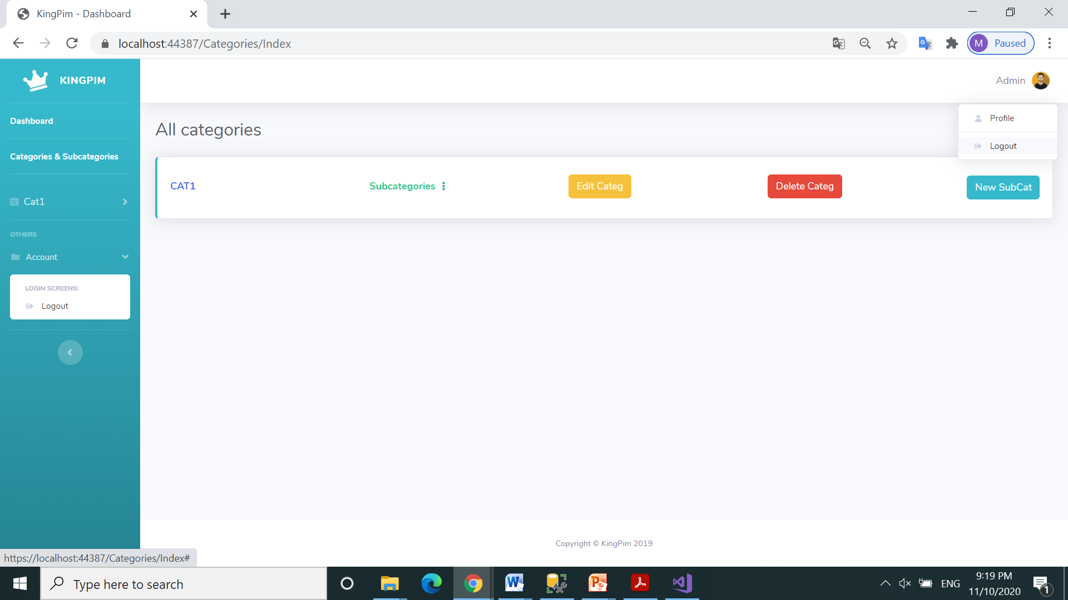
Click to Logout. User has 2 possibilities

Slide 34
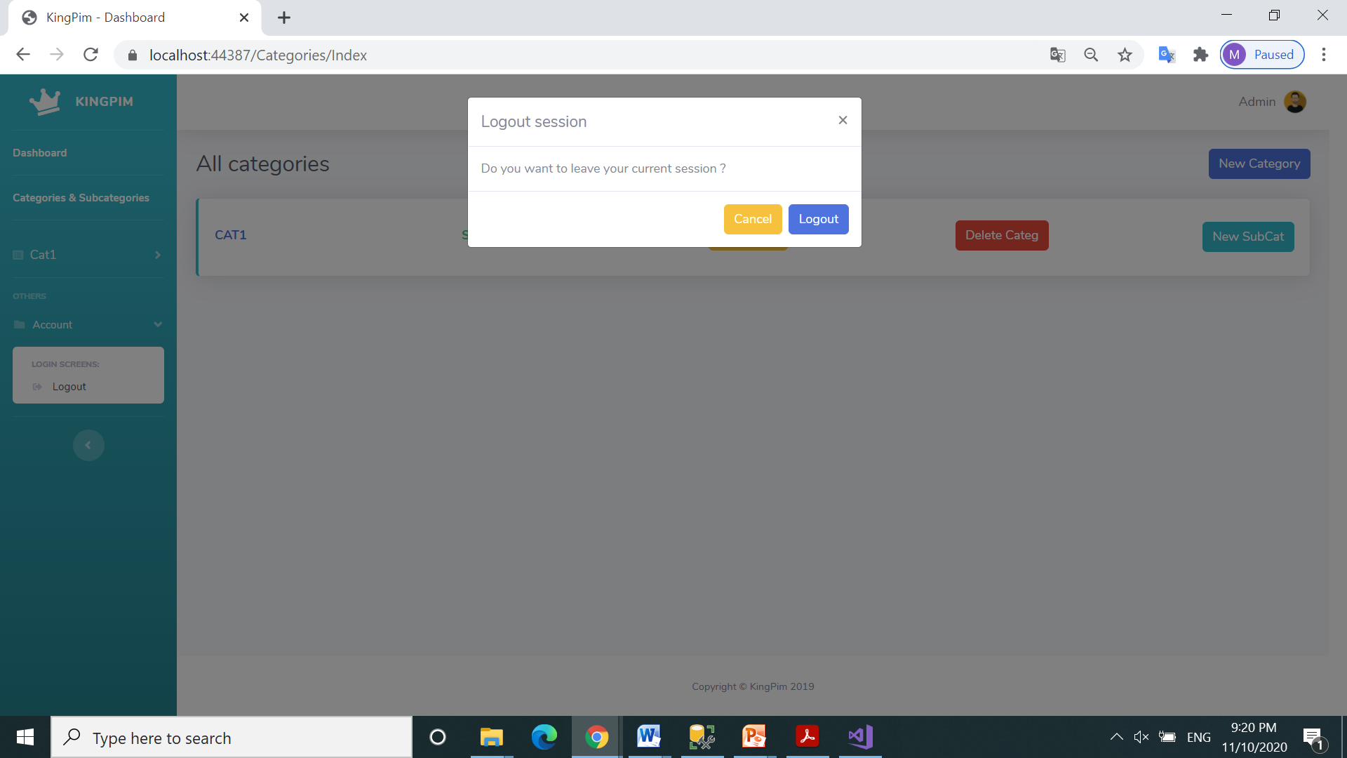
Confirm Logout

Slide 35
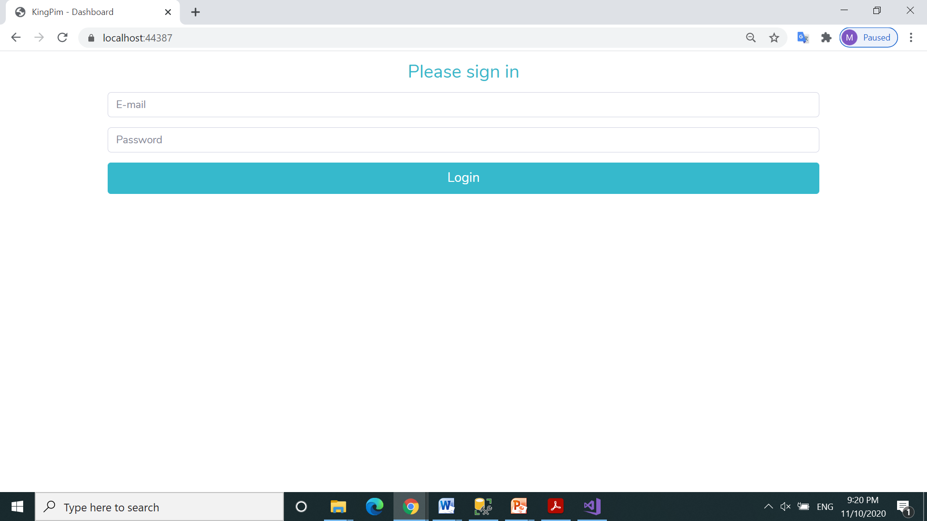
Thanks !

